Slide 1
Can a network-based attitude space inform social identification? Introducing a novel approach to research attitude-identity relationships
Adrian Lueders, Dino Carpentras, Michael Quayle

Slide 2
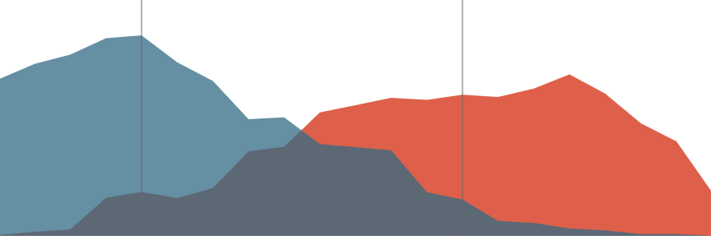
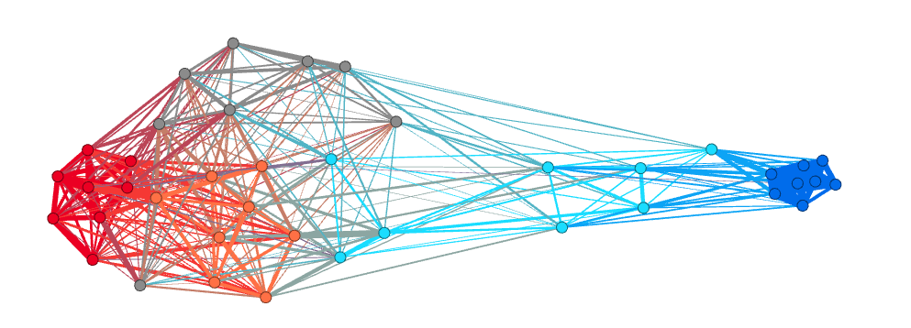
Linear spectrum
Network / Item response theory

Slide 3
Fundings
This project has received funding from the European Union’s Horizon 2020 research and innovation programme under the Marie Skłodowska-Curie grant agreement No 891347 and from the European Research Council (ERC) under the European Union’s Horizon 2020 research and innovation programme (grant agreement No. 802421).

Slide 4
Warning
Improper language ahead

Slide 5
How our method works

Slide 6
Abortion
Country music
Abortion
Gay rights
D

Slide 7
Similarity link
Abortion
Country music
Abortion
Gay rights
D

Slide 8
Similarity link
Abortion
Country music
Abortion
Gay rights
D

Slide 9
Attitudes
We are based on IRT
Every node is not an item
But an item-response
We call them attitudes
Abortion legal:Strongly agree ≠ Abortion legal:Strongly disagree
Abortion
Abortion
😐
Abortion

Slide 10
Distance
Abortion
Country music
Abortion
Gay rights
D

Slide 11
Clusters

Slide 12
Node: item-response
Gay rights😐
Gay rights👎
Gay rights👍
Women rights👍
Abortion👍

Slide 13
Node: item-response
Low prb
High prb of being selected together

Slide 14
The data

Slide 15
The data
Prolific academic
Americans
N= 402
8 political items
5 levels
SD = Republican
SA = Democrat
Self identification

Slide 16
What we expected

Slide 17
What we expected
Strongly Disagree, Weakly Disagree, Neutral, Weakly Agree, Strongly Agree
(using only 3 items for visual representation)

Slide 18
What we expected
Strongly Disagree, Weakly Disagree, Neutral, Weakly Agree, Strongly Agree
(using only 3 items for visual representation)

Slide 19
Levels
Strongly Disagree, Weakly Disagree, Neutral, Weakly Agree, Strongly Agree

Slide 20
Levels
Strongly Disagree, Weakly Disagree, Neutral, Weakly Agree, Strongly Agree

Slide 21
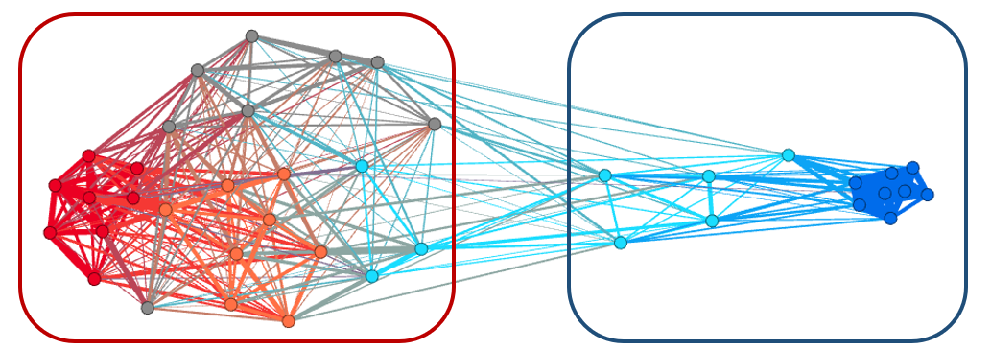
Is this an artifact?
If you Weakly Agree that abortion should be legal, you are on the Republican Side

Slide 22
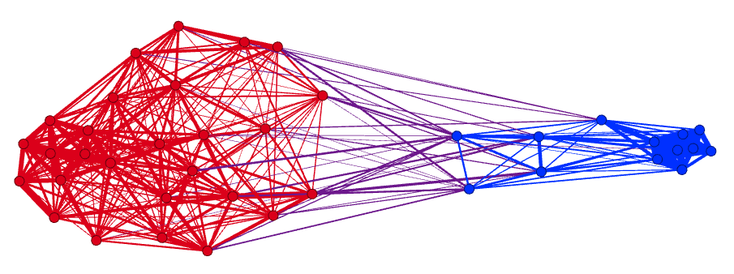
Self ID
Correlation with self-identification as Democrat
[Discretized]
blue = positive;
red = negative

Slide 23
Self ID
Correlation with self-identification as Democrat
[Discretized]
blue = positive;
red = negative

Slide 24
Why?
Democrats seem to have a clear positioning on some subjects
E.g. Abortion ->Strongly Agree

Slide 25
Why?
2 groups: flat-earthers and non-
1 item:
«Earth is not flat:»
Non flat-earthers
Flat earthers
WA N WD SD
SA

Slide 26
Self ID
Correlation with self-identification as Democrat
[Discretized]
blue = positive;
red = negative

Slide 27
Other main results
On the same dataset
People like more close attitudes
There are many ways to be republican
On other datasets
Asymmetry in the opinion space
Neutral have more in common with one side
Which attitudes are more important for defining a party

Slide 28
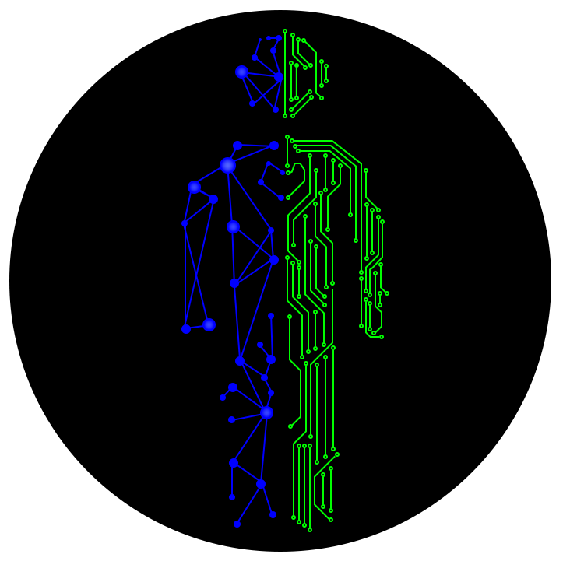
Contacts
www.dinocarp.com
dino.carpentras@gmail.com
@JustaNormalDino
Social Complexity
Preprints coming up soon!

