Slide 1
Differences in the attitude space of European left and right-wing supporters
Dino Carpentras, Michael Quayle
Social Dynamics Lab
12/7/2021

Slide 2
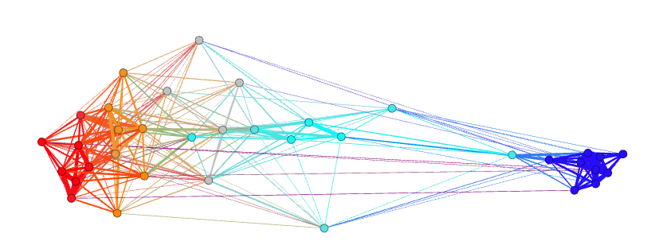
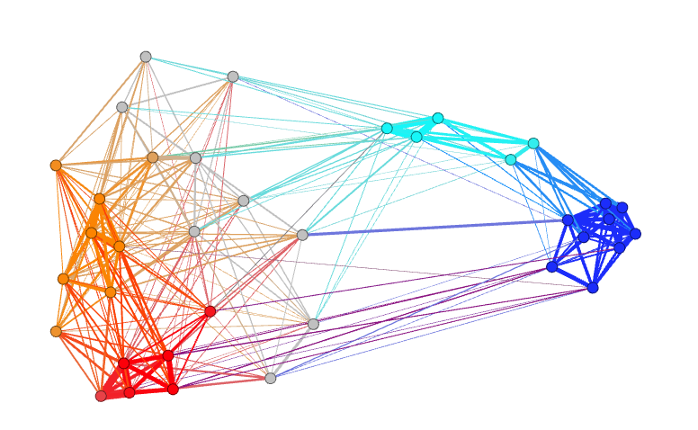
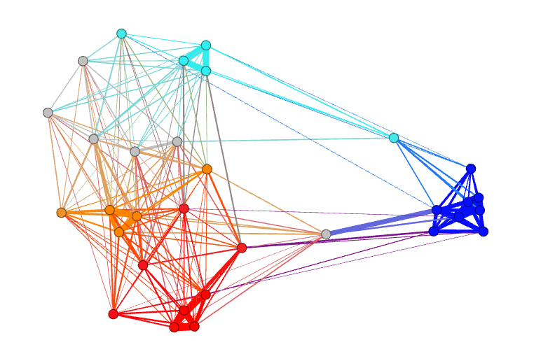
Preview
Germany
Italy
UK
Spain

Slide 3
BNA + IRT
BNA = Belief Network Analysis
IRT = Item Response Theory
Attitude space

Slide 4
Attitude space

Slide 5
Attitude space: people

Slide 6
Attitude space: item-responses
Abortion
Abortion
Abortion
😐
Abortion
Abortion

Slide 7
Belief network analysis

Slide 8
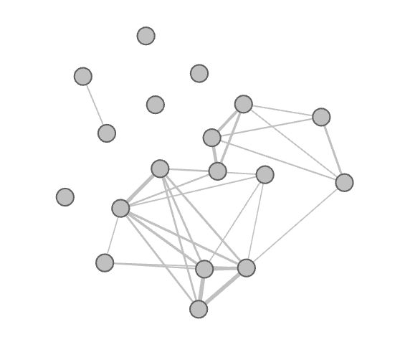
Belief network analysis
Node: Item
Link: Correlation
Analysis of the network
Identity
Polarization
Boutyline,Vaisey. "Belief network analysis: A relational approach to understanding the structure of attitudes." American journal of sociology 2017

Slide 9
Limitations
Trust police
Nominal answers
Non-linear relationships
Non-monotonic relationship
Symmetric groups
Left-Right

Slide 10
A
B
C

Slide 11
A
B
C

Slide 12
A
B
D
C
?
?

Slide 13
Groups similarity

Slide 14
Groups similarity

Slide 15
Are they symmetric?
Extreme left
Right leaning
Left leaning
Neutral
Extreme Right

Slide 16
Abortion
Country music
Abortion
Gay rights
D

Slide 17
Similarity link
Abortion
Country music
Abortion
Gay rights
D

Slide 18
Similarity link
Abortion
Country music
Abortion
Gay rights
D

Slide 19
Distance
Abortion
Country music
Abortion
Gay rights
D

Slide 20
Clusters

Slide 21
Node: item-response
Gay rights😐
Gay rights👎
Gay rights👍

Slide 22
IRT -> Attitude space
Gay rights😐
Gay rights👎
Gay rights👍

Slide 23
The ESS
Italy

Slide 24
The ESS
Italy
Political attitudes
2016 data
Correlates with Left-Right spectrum

Slide 25
p-value
Italy 2016
bootstapping
p<<0.0001

Slide 26
The uneven distribution

Slide 27
Polarization among countries
Germany
Italy
UK
Spain
Same LR structure
in 76% of countries

Slide 28
Conclusion
We can analyze in detail the opinion space
What divides and unifies L&R
Analyze each side
Adding complexity to polarization
Right wing is connected to more attitudes
Left wing is more compact
Further analyses
Time analysis

Slide 29
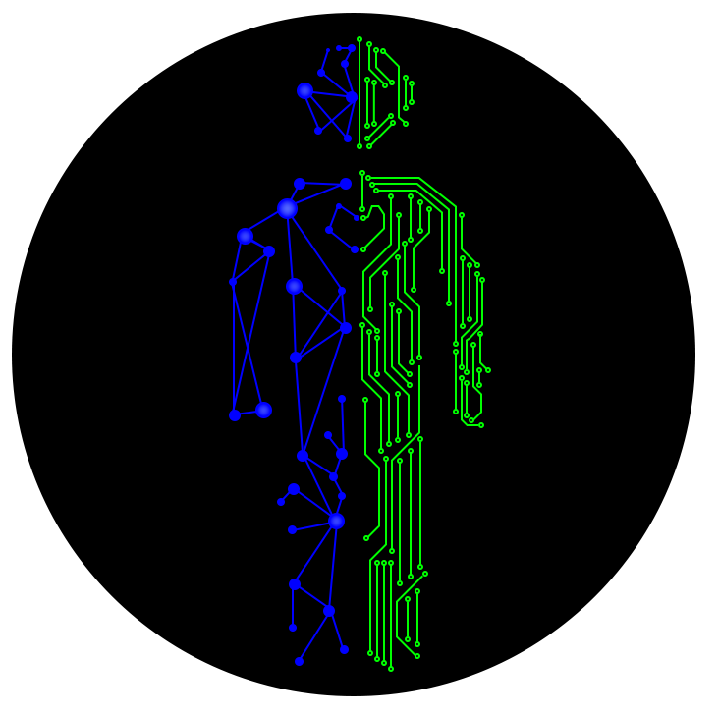
Contacts
Related talks
www.dinocarp.com
dino.carpentras@gmail.com
@JustaNormalDino
Social Complexity
Monday
- New Methods for Old Questions: Measuring Political Attitudes 13.30 CET - Room 5
- Identity and Politics 13.50 CET – Room 1
Tuesday
- Attitudes, personality, and cognition 7.30 CET – Room 4

