Slide 1
What is an opinion? The problem of weakly-defined measurements in agent-based modeling
Dino Carpentras, Michael Quayle

Slide 2
A blog post describing this content can be found here:
https://www.dinocarp.com/when-and-why-you-can-actually-compare-measurements-from-the-social-sciences/

Slide 3
Overview
(Theoretical) ABModels
Real world data
More complex than expected

Slide 4
Disclaimer
Every field is unique
Unique features
Better research
New possibilities

Slide 5
Fundings
This project has received funding from the European Union’s Horizon 2020 research and innovation programme under the Marie Skłodowska-Curie grant agreement No 891347 and from the European Research Council (ERC) under the European Union’s Horizon 2020 research and innovation programme (grant agreement No. 802421).

Slide 6
Research focus
Theoretical
Empirical

Slide 7
Research focus
Theoretical
Empirical

Slide 8
In physics
Theoretical
Empirical
Notes:
Something similar happens in math/phisics

Slide 9
In physics
Theoretical
Empirical
Why?
Notes:
Something similar happens in math/phisics

Slide 10
Physics model
$$v= \frac{dx}{dt}$$

Slide 11
Physics model
$$v= \frac{dx}{dt}$$

Slide 12
Operative definitions

Slide 13
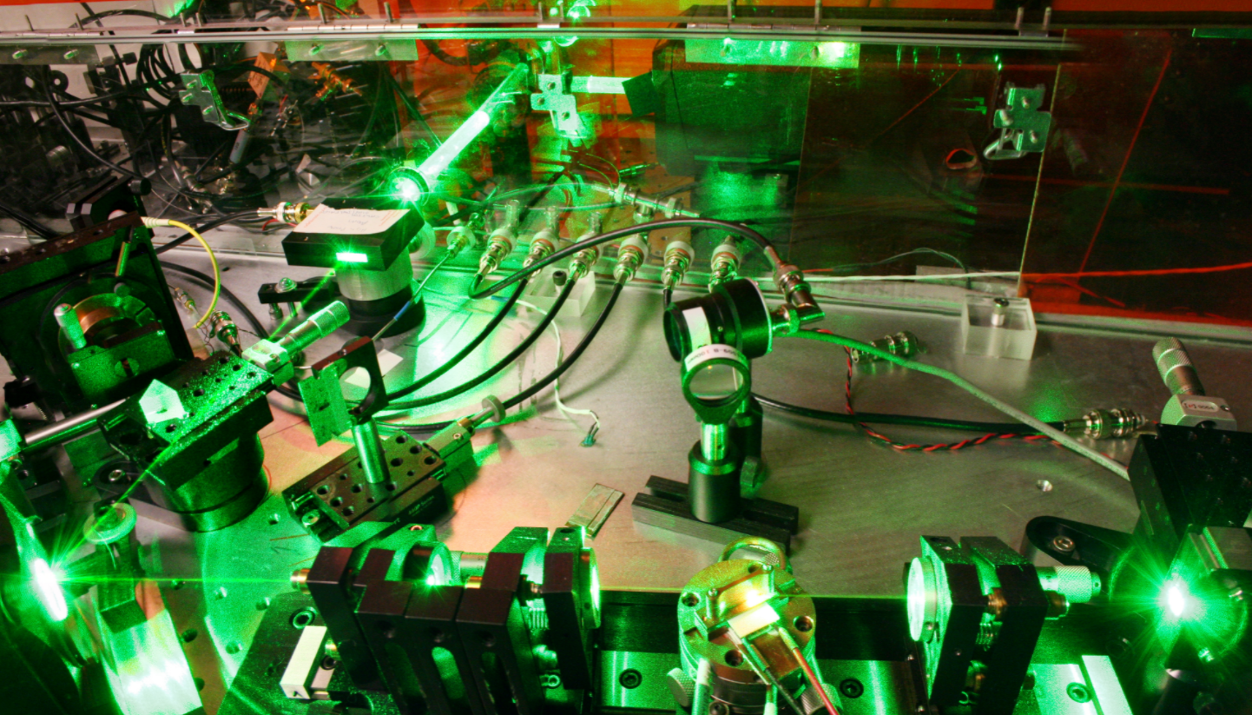
Operative definitions

Slide 14
Two people
$$v= \frac{dx}{dt}$$
$$v= \frac{dx}{dt}$$

Slide 15
Physics
Reality
Model
Measurement

Slide 16
ABM
Reality
Model

Slide 17
They are rooted but qualitatively
Bounded confidence -> homophily
1
2
3
4
1
2
3
4

Slide 18
ABM model
$$o_{i}\left(t+1\right)=o_{i}\left(t\right)+o_{j}(t)$$

Slide 19
ABM model
$$o_{i}\left(t+1\right)=o_{i}\left(t\right)+o_{j}(t)$$

Slide 20
Non-operative definitions

Slide 21
Two people
$$o_{i}\left(t+1\right)=o_{i}\left(t\right)+o_{j}(t)$$
$$o_{i}\left(t+1\right) ?=? o_{i}\left(t\right)+o_{j}(t)$$

Slide 22
An example

Slide 23
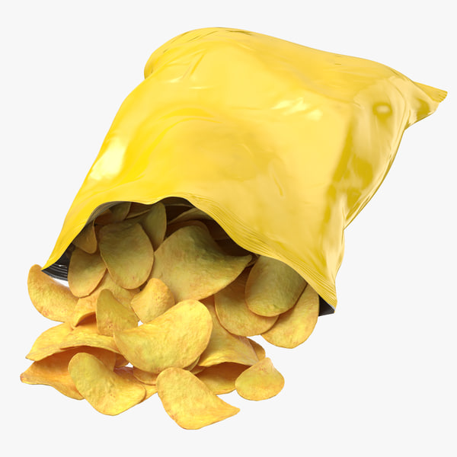
Count the chips in a bag

Slide 25
1
0
?
6
4

Slide 26
Also non-operative

Slide 27
Static comparison
Scale 1
Scale 2
Scale 3

Slide 28
Static comparison
Scale 1
Scale 2
Scale 3
They are measuring
different things!

Slide 29
Dynamic

Slide 30
Dynamic
$$+$$

Slide 31
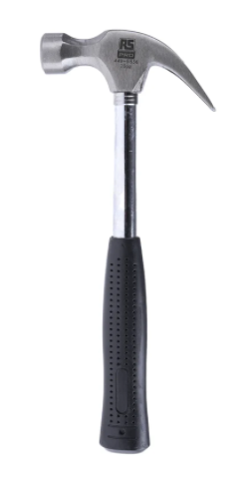
Dynamic

Slide 32
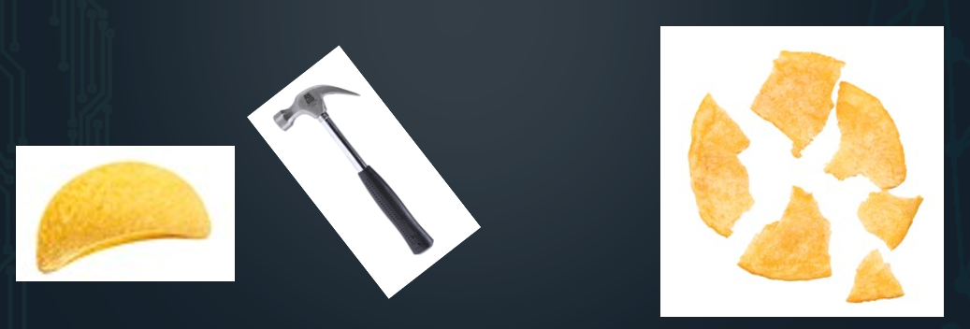
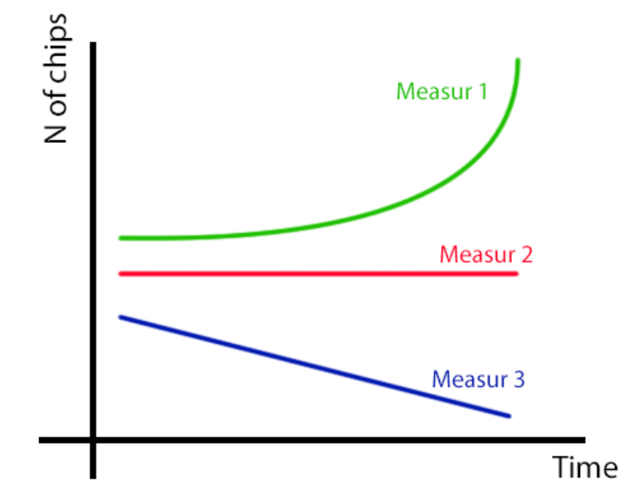
Dynamic

Slide 33
Dynamic
Different
dynamics

Slide 34
Operative
definitions
Model
Meas 1
Dyn 1
Definition
Chips
Meas 2
Dyn 2
Meas 3
Dyn 3

Slide 35
In real data

Slide 36
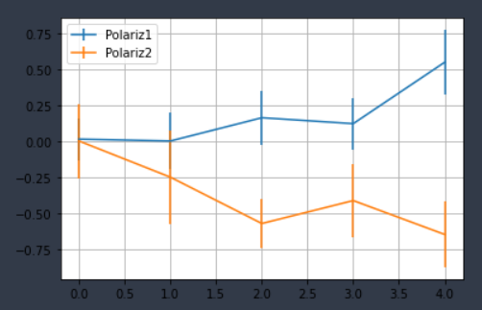
Polarization
DellaPosta, D. (2020). Pluralistic collapse: The “oil spill” model of mass opinion polarization. American Sociological Review, 85(3), 507-536.

Slide 37
In ABM
Experiments
Link model to data
Theoretical analysis

Slide 38
Experimental OD
The measurement determines the effects you observe
(i.e. the model rules)

Slide 39
Experimental OD
The measurement determines the effects you observe
(i.e. the model rules)
New measurement -> new dynamics

Slide 40
Hypothesis
Operative
definitions
Meas 1
Definition
Opinion
Meas 2
Same dyn
Meas 3

Slide 41
Hypothesis
Operative
definitions
Meas 1
Model
Definition
Opinion
Meas 2
Prediction
Meas 3

Slide 42
Predictions
Trust in science
Deffuant model
Meas 1
Model
Trust
Meas 2
Distrust

Slide 43
Predictions
Meas 1
Model
Pred 1
Meas 2
Pred 2
The model does not work with both measurements

Slide 44
3 models of od
Meas 1
Model 1
Sim ground truth
Meas 2
Model 2
Pred 1
Meas 3
Model 3

Slide 45
Physics
Reality
Model
Measurement

Slide 46
ABM
Model 2
Measurement 2
Reality
Measurement 1
Model 1

Slide 47
Relevance for ABM
A problem
Connecting to real-data
A possibility
Show when models are equivalent
New effects
New models
New research paths
Scale calibration

Slide 48
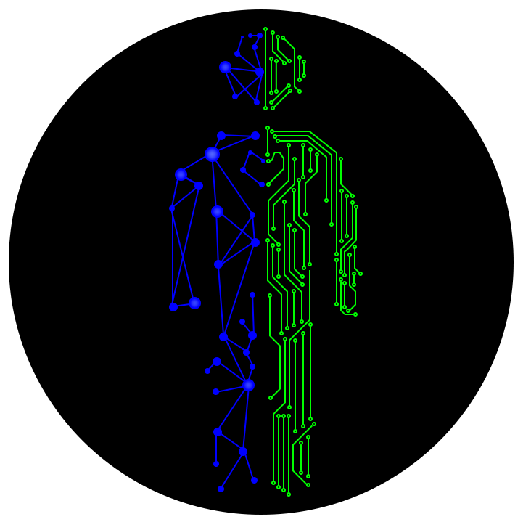
Contacts
Readings
www.dinocarp.com
dino.carpentras@gmail.com
@JustaNormalDino
Dino Carpentras
Carpentras et al., The sensitivity of the Deffuant model to measurement error, preprint available
Carpentras et al., A new degree of freedom for opinion dynamics models: the arbitrariness of scales, ArXiv
Carpentras & Quayle, The psychometric house-of-mirrors: the effect of measurement distortions on agent-based models’ predictions, under review
Carpentras et al., Building An Opinion Dynamics Model From Experimental Data, under review

