Slide 1
The psychometric house-of-mirrors: the effect of measurement distortions on agent-based models’ predictions
Dino Carpentras, Michael Quayle

Slide 2
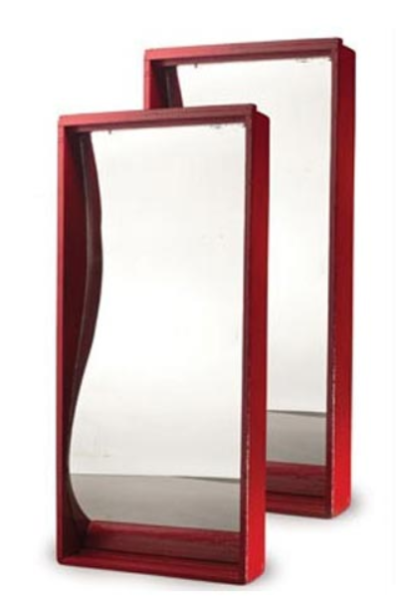
Distortions
Very different from noise
Studied in Psychometrics
How they impact psych. models
Niche & complex
Relevance for ABM (+data)
Improved performances
New types of models

Slide 3
Fundings
This project has received funding from the European Union’s Horizon 2020 research and innovation programme under the Marie Skłodowska-Curie grant agreement No 891347 and from the European Research Council (ERC) under the European Union’s Horizon 2020 research and innovation programme (grant agreement No. 802421).

Slide 4
Distortions
No distortions
Position
Speed
Power
Income
…
Opinion
Happiness
Stubborness
…
Have units
Do not have units

Slide 5
Where do distortions come from?
Ordinal scales
Measurements which preserve only the order

Slide 6
Measure people

Slide 7
Measure people
1
2
3
4

Slide 8
Measure people
Height
scale
1
2
3
4

Slide 9
Measure people
3
1
2
3
4

Slide 10
Measure people
1
1
2
3
4

Slide 11
Measure people
No unit
1
1
2
3
4

Slide 12
1
2
3
Green
scale
Red
scale
1
2
3

Slide 13
1
2
3
Green
scale
Red
scale
1
2
3

Slide 14
1
2
3
4
1
2
3
4

Slide 15
1
2
3
4
1
1
1
2
3
4

Slide 16
1
2
3
4
3
2
1
2
3
4

Slide 17
1
2
3
4
4
4
1
2
3
4

Slide 18
$$1 m =3.2 ft$$
$$Scale1≠α Scale2$$

Slide 19
Distortions
$$1 m =3.2 ft$$
$$Scale1≠α Scale2$$

Slide 20
Metaphor
House of mirrors

Slide 21
Like distorted mirrors
Preserve order
Not proportions

Slide 22
Almost like distorted mirrors
No ground truth
No one is better
Good
Good
Good

Slide 23
Measur 1
Measur 5
Opinion
Measur 2
Measur 4
Measur 3

Slide 24
Measur 1
Measur 5
Opinion
Measur 2
Measur 4
Not like noise
Measur 3

Slide 25
Why different measurements?

Slide 26
Collecting data
Where on the LR are you?
Average
Abortion
Immigration
Gay rights
…
Explicit measures
Use sliders
Numbers: 0 100
Words (Strongly Agre…)
Icons
Implicit measures

Slide 27
Data processing
Compensation
Factor analysis
Item response theory
Different models

Slide 28
Measur 1
Measur 5
Opinion
Measur 2
Measur 4
Measur 3

Slide 29
Distortions in real data

Slide 30
Multiple items scales
Average score from Scale 2
Score from Scale 1

Slide 31
Distortions in real data
Average score from Scale 2
Score from Scale 1

Slide 32
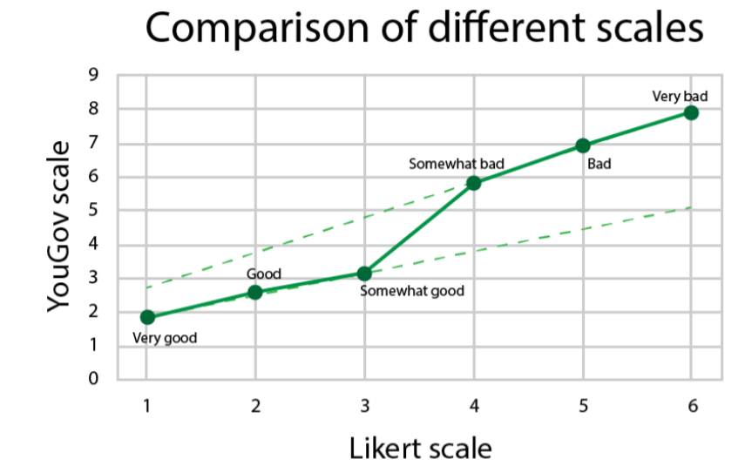
Single item scales

Slide 33
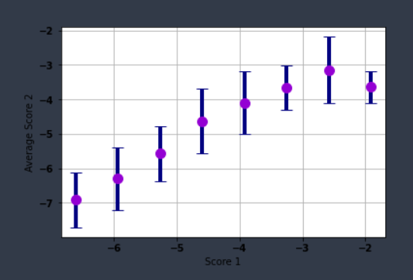
Using factor analysis…

Slide 34
The effect of distortions on ABM

Slide 35
Just plug the data in
Model
Population
Measurement
Prediction

Slide 36
Just plug the data in
Model
Population
Measurement
Prediction
Predictions depend only on the model or noise

Slide 37
Hidden assumption
Scale1
Model
Population
Pred
Scale2

Slide 38
In simulations

Slide 39
Simulations
Deffuant model
Scale 1
Model
Pred 1
Generate the intial data
Scale 2
Pred 2
Reference scale

Slide 40
Simulations
Scale 1
Scale transformation
Generate the intial data
$$x^{n}$$
Scale 2
Opinions in the same interval (0,1)

Slide 41
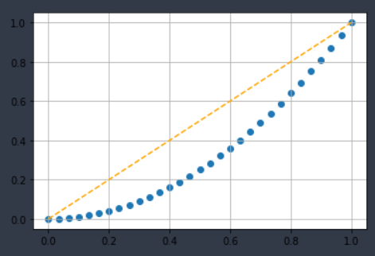
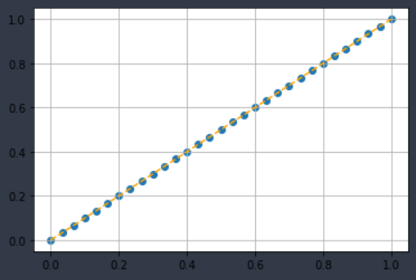
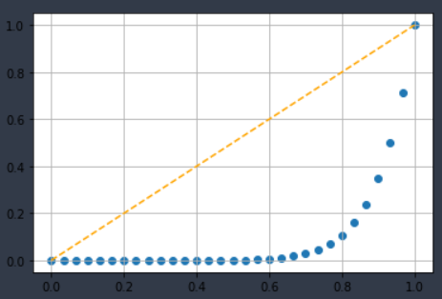
Simulations
$$x^{n}$$
Distortion’s magnitude (n) | 1 | 2 | 5 | 10 | 100
Error | 0% | 17% | 34% | 41% | 50%

Slide 42
Real data

Slide 43
Using real data
Scale 1
Model
Trust
10% 20%
Population
Scale 2
Distrust

Slide 44
So what?

Slide 45
The best scale
Best scale
Model
Maximum accuracy
Real world
Other scales
Lower
accuracy

Slide 46
So what?
Model
Bad predictions
Data
Low noise
Big sample

Slide 47
So what?
Model
Poor
scale
Bad predictions
Data
Low noise
Big sample

Slide 48
So what?
Optimization
Model
Poor
scale
Bad predictions
Data
Low noise
Big sample

Slide 49
So what?
Optimization
Model
Good
scale
Better predictions
Data
Low noise
Big sample

Slide 50
So what?
Model
Good
scale
Good predictions
French data
Same topic
Same data interval
Same sample size
Same stats properties
Model
Poor
scale
Bad predictions
German data

Slide 51
An opportunity
More complexity
Qualitative approach
Distortions affect the predictions quality
Understand better
More solid predictions
Ordinal models
New methods
We can find the best scale

Slide 52
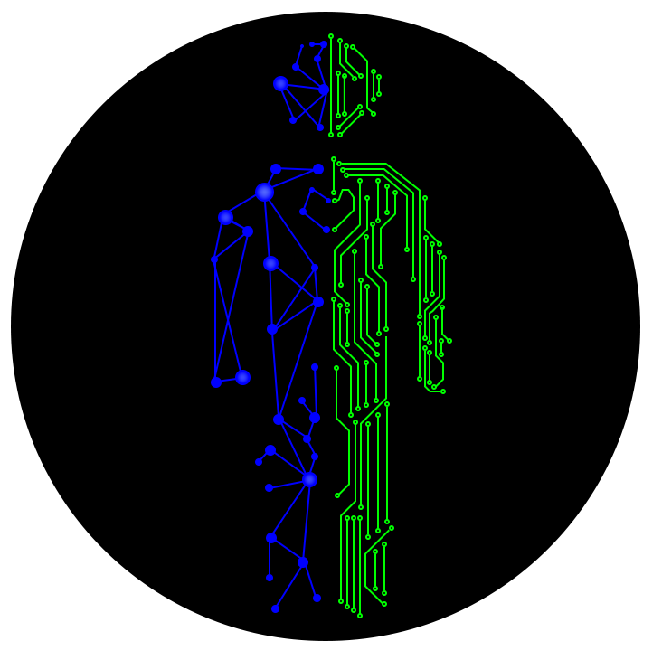
Contacts
Readings
www.dinocarp.com
dino.carpentras@gmail.com
@JustaNormalDino
Dino Carpentras
Carpentras et al., The sensitivity of the Deffuant model to measurement error
Carpentras et al., A new degree of freedom for opinion dynamics models: the arbitrariness of scales

