Slide 1
Building an Opinion Dynamics Model from Experimental Data
Dino Carpentras, Paul J. Maher, Caoimhe O’Reilly, Michael Quayle

Slide 2
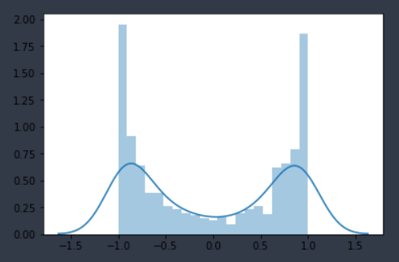
Overview
Polarized
Strong diversity
Dynamic convergence
Frequency (a.u)
Opinion

Slide 3
Fundings
This project has received funding from the European Union’s Horizon 2020 research and innovation programme under the Marie Skłodowska-Curie grant agreement No 891347 and from the European Research Council (ERC) under the European Union’s Horizon 2020 research and innovation programme (grant agreement No. 802421).

Slide 4
Structure
Introduction
Design
Data collection & analysis
OD model

Slide 5
Structure
Introduction
Design
Data collection & analysis
OD model

Slide 6
Opinion Dynamics
1
2
3
4

Slide 7
Opinion Dynamics
Update rule
Quantitative
Need quantitative measurement
$$o_{i}\left(t+1\right)=μo_{i}\left(t\right)+(1−μ)o_{j}(t)$$

Slide 8
Structure
Introduction
Design
Data collection & analysis
OD model

Slide 9
One model fits it all?
Context
Formal dinner / Bar / Facebook
different possible interactions
Topics
E.g. Gun control VS best ice cream flavour VS vaccination
Measurement

Slide 10
Context
Online interaction
Simple & controlled interaction
Only agree/disagree

Slide 11
Different topics
Average of different topics
Gun control ≠ immigration ≠ vaccines
All different
Novel topics
All similar behavior (?)

Slide 12
Novel statements
Circle is a noble shape
Letter P is boring
…

Slide 13
Problems?
Are they meaningful?
They are not interesting

Slide 14
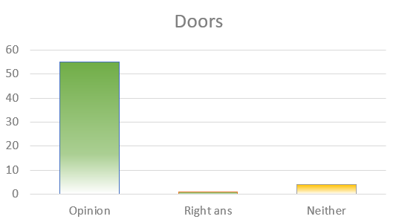
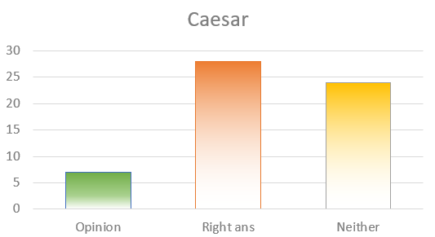
Tests
Significantly more meaningul

Slide 15
Is realistic?

Slide 16
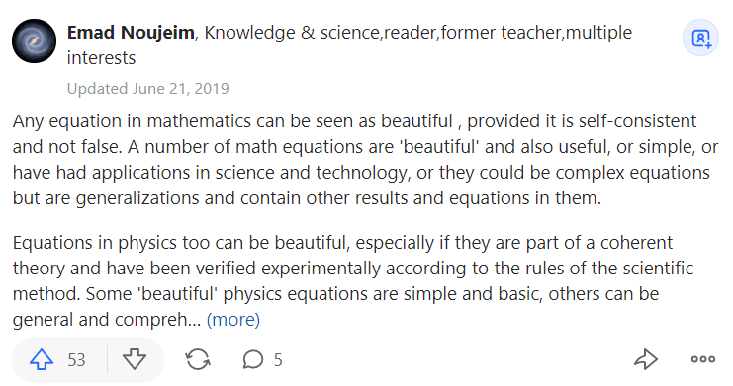
Meaningfulness

Slide 17
Final situation
Novel topics in real life
Beautiful equations / Bitcoins
As baseline for comparison
E.g. perfect rationality

Slide 18
Novel attitudes
Established attitudes

Slide 19
Structure
Introduction
Design
Data collection & analysis
OD model

Slide 20
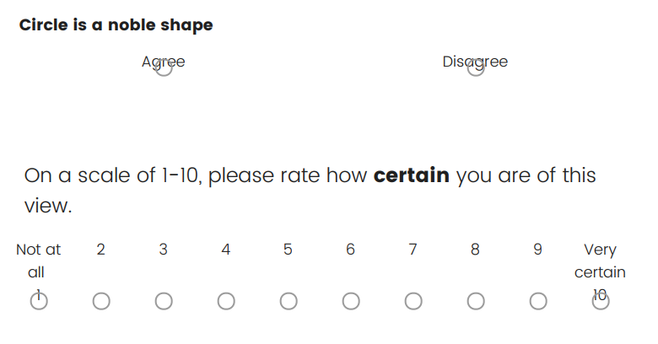
Collection

Slide 22
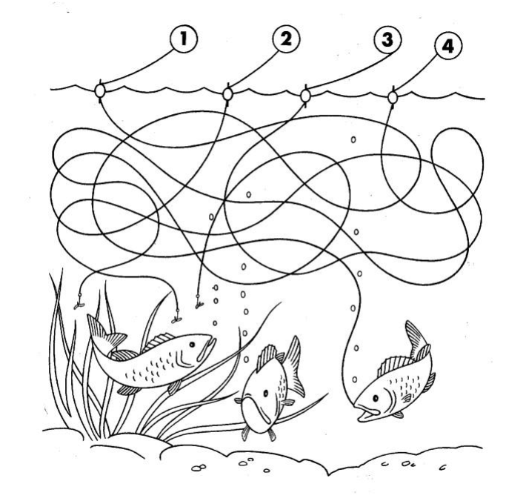

Slide 23
Collection

Slide 24
Dataset
N=365, Age: 18 - 69, M=31.08, SD=11.39 Gender: male 160, female 205, other 0

Slide 25
Opinions as numbers
Agreement [Agree/Disagree] -> [+1/-1]
Certainty [0.1,1]
Opinion = [+1/-1] * [0.1,1] = [-1,1]

Slide 26
Social influence
-1
0
1
-1
0
1

Slide 27
Social influence
-1
0
1
Mean movement ~0.03
p<0.05
-1
0
1

Slide 28
Dynamic?

Slide 29
Plotting
Op @ time 2
Every dot is one person
at time 1 and 2
for the same question
Op @ time 1

Slide 30
Example 1
Op2
op2=op1
0.8
Increased op (and certainty)
0.5
Same op (and certainty)
0.3
Decreased op (and certainty)
Op1
0.5

Slide 31
Op2
Op1
0.5
-0.5
Changed agreement
While keeping same certainty

Slide 32
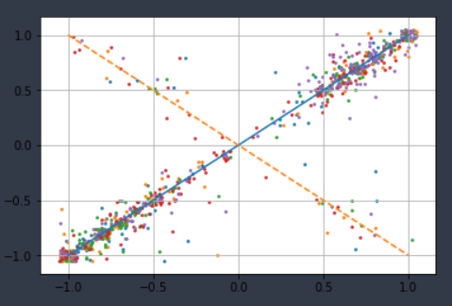
The shape of our data
Every color is a different topic

Slide 33
The shape of our data
Every color is a different topic
Roughly an X

Slide 34
What does it mean?
People tend to keep the same opinion
+ noise

Slide 35
Peculiarity of noise
The more certain someone is, the less noisy he is
Op2
-0.05
+-0.15
+-0.25
Op1
0.1
1

Slide 36
Peculiarity of noise
The more certain someone is, the less noisy he is
Op2
-0.05
+-0.15
+-0.25
Is it noise?
Op1
0.1
1

Slide 37
What does it mean?
People tend to keep the same opinion
+ noise
Some switch op while keeping certainty

Slide 38
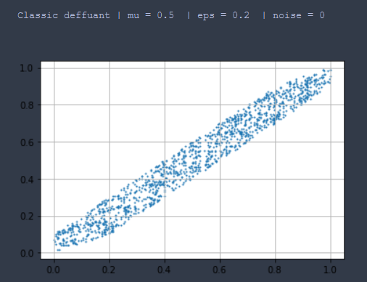
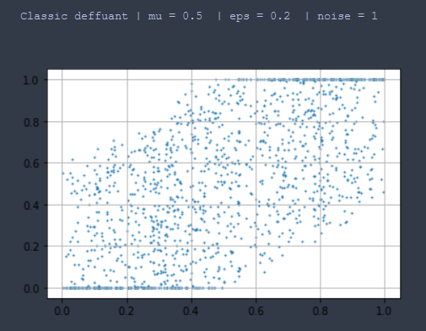
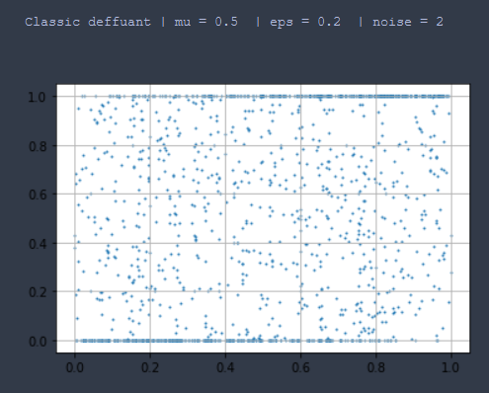

Slide 39
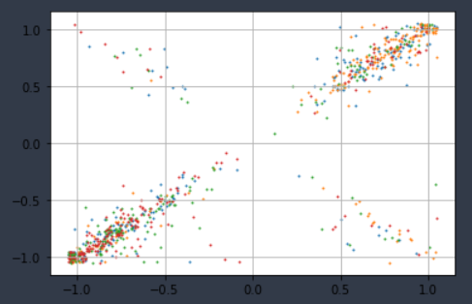
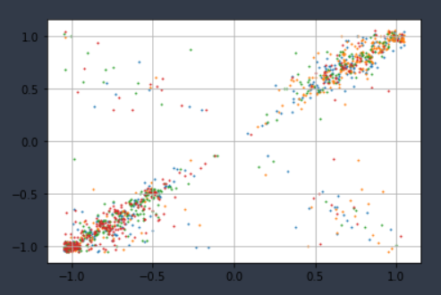
Other experiments
Condition 1
Condition 2

Slide 40
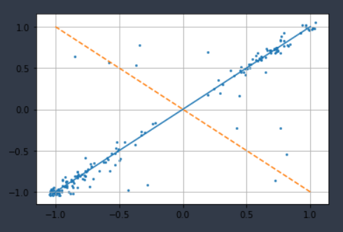
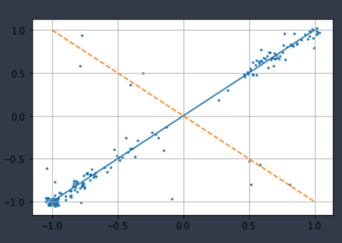
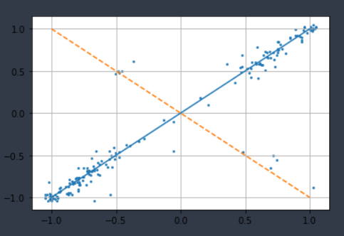
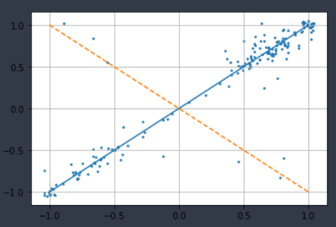
Same dynamics

Slide 41
Self-reflection

Slide 42
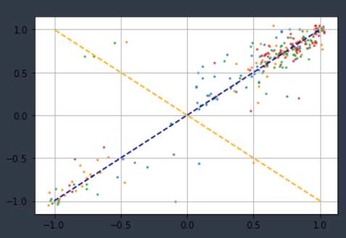
Self-reflection
Control group

Slide 43
Key findings
Stay close to initial position
“noise” decreases with higher certainty
4% flipping
Little influence (0.03)

Slide 44
Structure
Introduction / previous works
Design
Data collection & analysis
OD model

Slide 45
Building a model
Rules
We select a random pair of agents.
Agent 1 shifts her opinion in a random direction using the previously discussed normally distributed variable (effect 1).
With a probability of 4% agent 1 changes the sign of her own opinion (effect 2) unless the change already happened due to effect 1.
Agent 1 shifts her opinion in the direction of agent 2 by 0.03 (effect 3).
If the opinion is above 1 or below -1 we round it to the closest acceptable value (i.e. either +1 or -1).

Slide 46
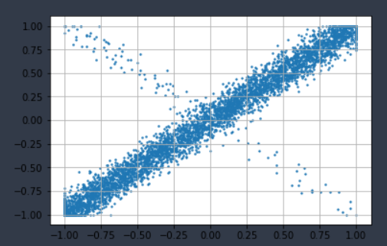
Transition probability
Real data
(multi topics)
Simulated data
(one simulated topic)

Slide 47
Opinion distribution
Final distribution
Polarized
Strong diversity
Dynamic convergence
Frequency
Opinion

Slide 48
Limitations
Negligible interaction
Topics are new forever

Slide 49
Future studies
Stronger interactions
Social identity
Non-novel topics

Slide 50
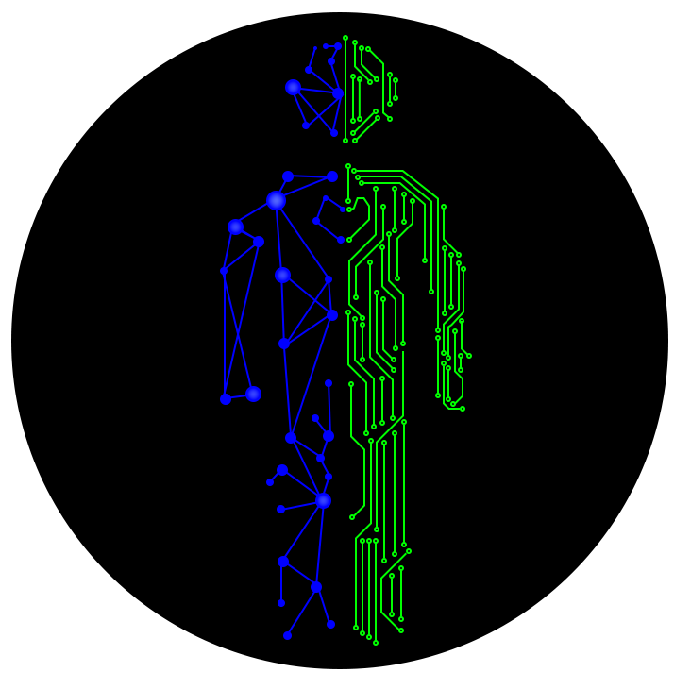
Contacts
www.dinocarp.com
dino.carpentras@gmail.com
@JustaNormalDino
Dino Carpentras

