Slide 1
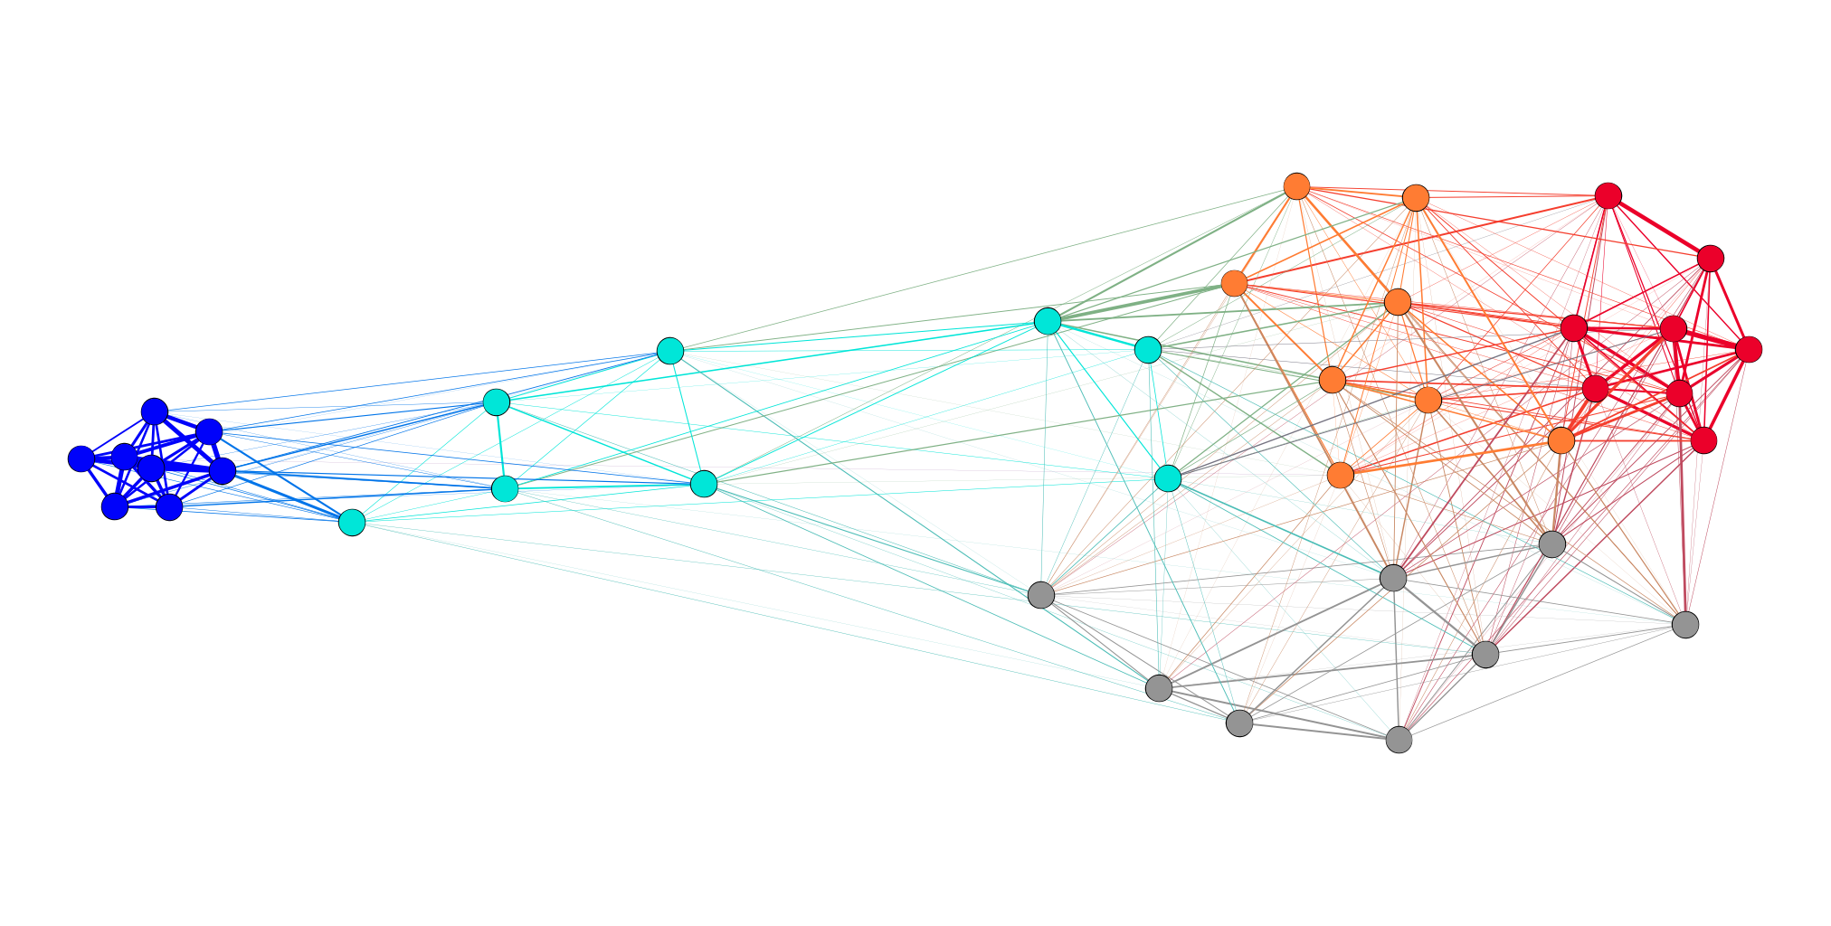
Intuitive meaning

Slide 2
How attitudes are linked by people
A
B
A
B
A
B
A
B

Slide 3
How attitudes are linked by people
A
B
A
B
A
B
A
B
A
B

Slide 4
How attitudes are linked by people
A
B
A
B
A
B
A
B

Slide 5
How attitudes are linked by people
A
B
A
A
B
B

Slide 6
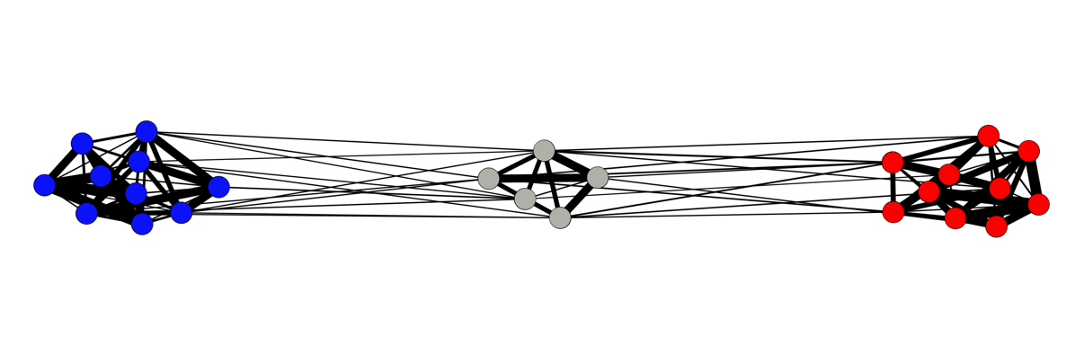
Example

Slide 7
Application: polarization
Monodimensionality
Partisanship

Slide 8
Neutrality
Neutral att.s
Democrat att.s
Republican att.s

Slide 9
Neutrality
Neutral att.s
Democrat att.s
Republican att.s

Slide 10
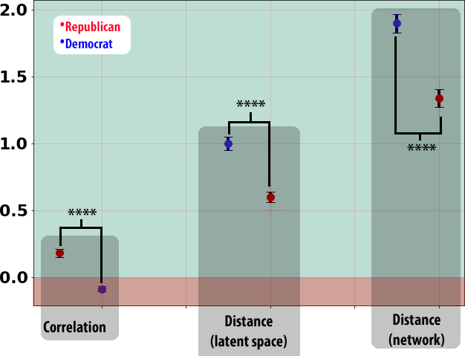
Connection with the neutrals

Slide 11
Also on evaluation
Republican like more independents
Democrats like less independents

Slide 12
Meaning
You cannot express neutrality
Whatever you say will place you on one of the two sides of the fence

